Slide 1

DataSpark: Illuminating Insights for Global Electronics

Slide 2
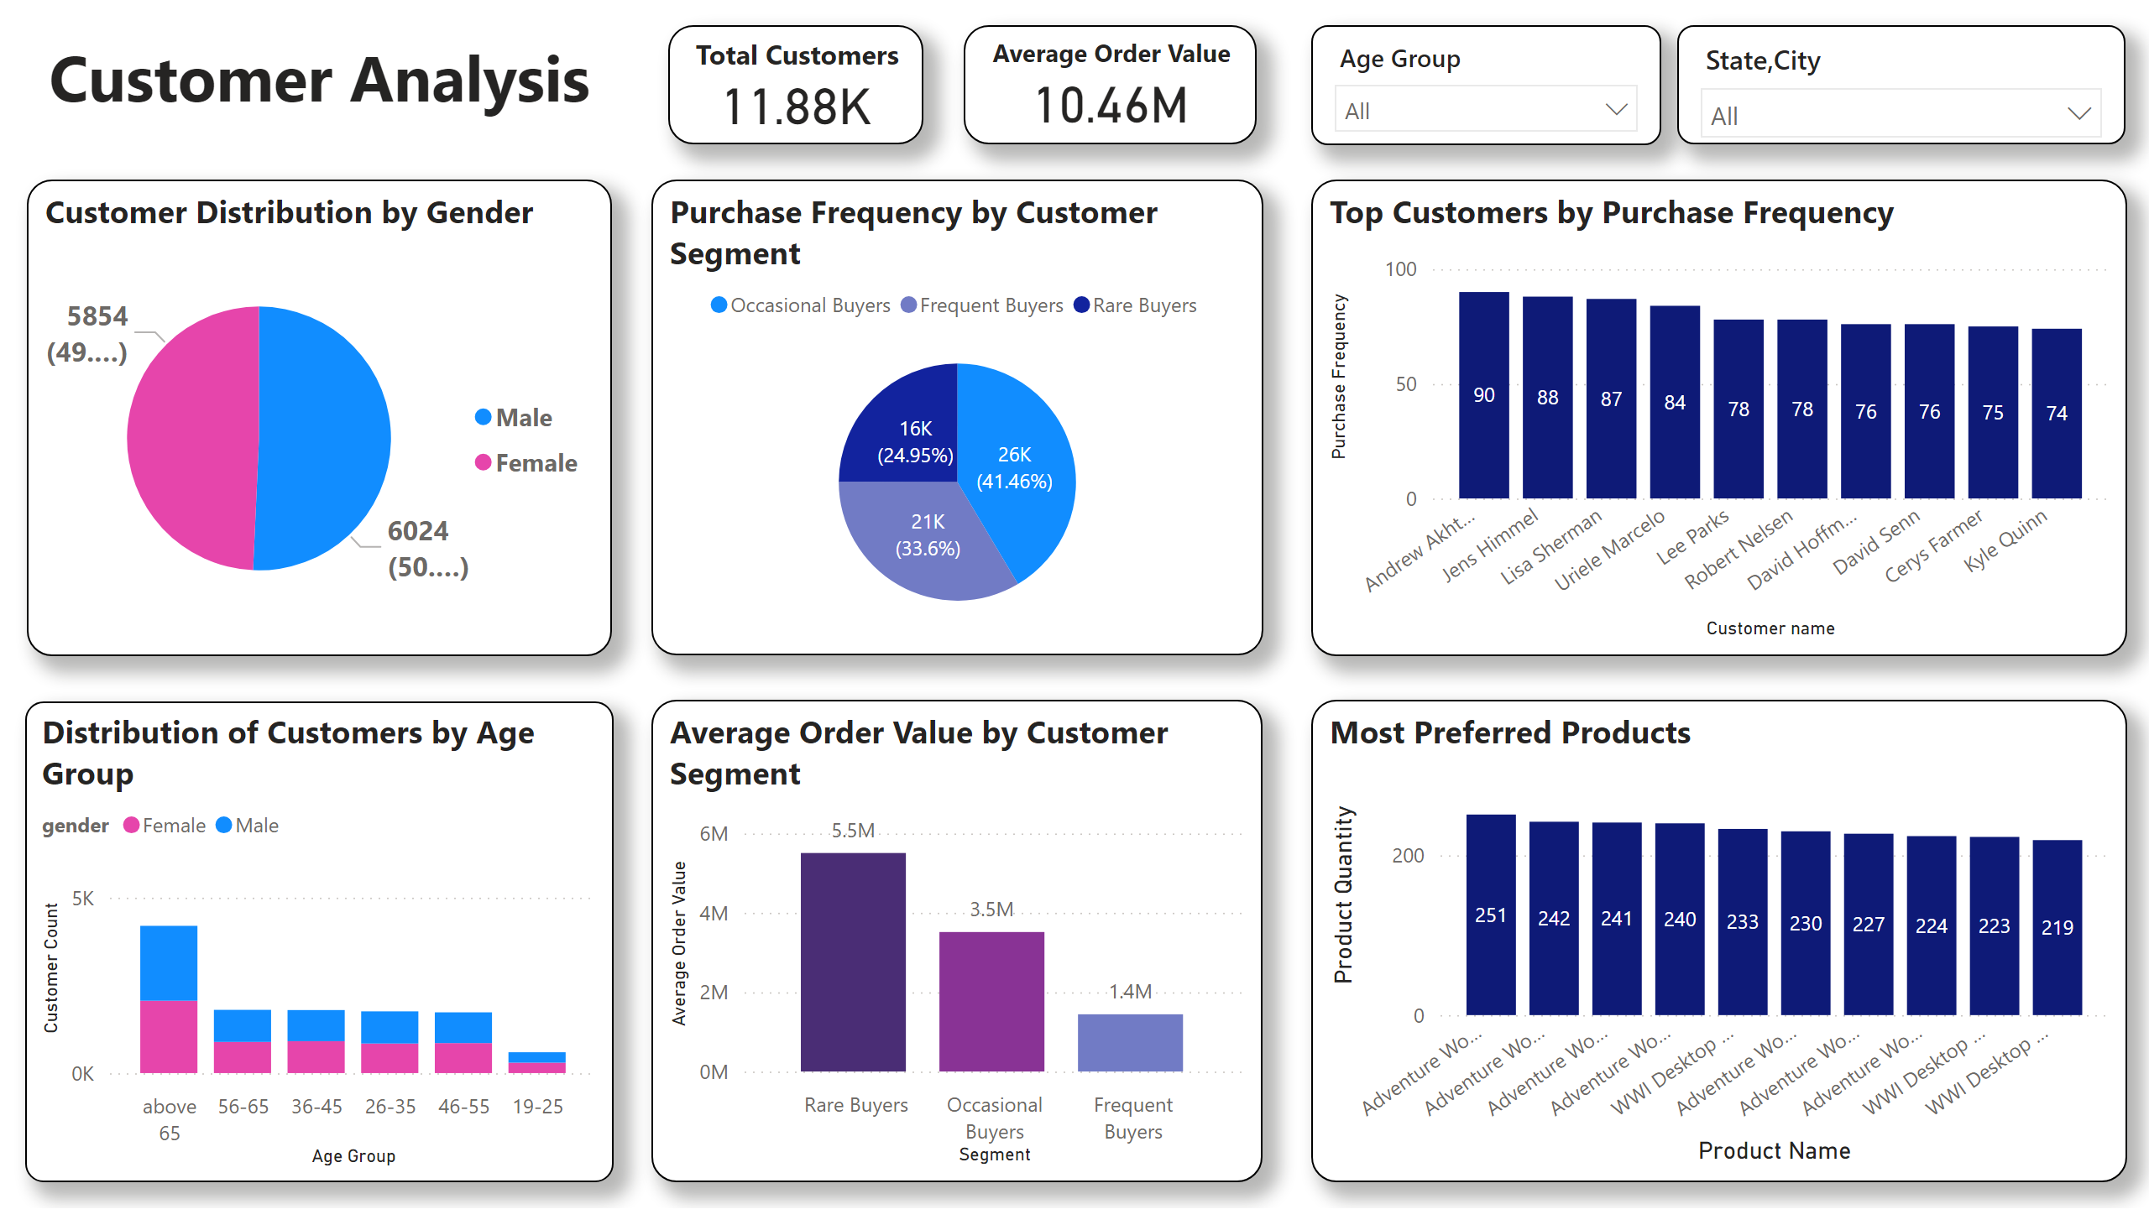
Customer Analysis
Notes:
Customer Distribution by Gender
No alt text provided
Top Customers by Purchase Frequency
No alt text provided
Average Order Value by Customer Segment
No alt text provided
Purchase Frequency by Customer Segment
No alt text provided
slicer
No alt text provided
slicer
No alt text provided
textbox
No alt text provided
Total Customers
No alt text provided
Distribution of Customers by Age Group
No alt text provided
Most Preferred Products
No alt text provided
Average Order Value
No alt text provided

Slide 3
Customer Analysis
Gender Distribution:
Male Customers: 6,024
Male accounted for 50.72% of Customer Count.
Age above 65 in gender Male made up 17.97% of Customer Count.
Female Customers: 5,854 (49%)
Customer Segments:
Rare Buyers: 24.95%
Frequent Buyers: 33.6%
Occasional Buyers: 41.46%

Slide 4
Purchase Behavior Analysis
Average Order Value: 10.46M
Rare Buyers: 5.5M
Occasional Buyers Segment: 3.5M
Frequent Buyers: 1.4M
Top Customers:
Andrew Akhtar: Top customer by purchase frequency at 90, Andrew Akhtar had the highest Purchase Frequency and was 21.62% higher than Kyle Quinn, which had the lowest Purchase Frequency at 74 (among the Top 10).

Slide 5
Product Analysis
Most Preferred Products:
Adventure Series:
Various products under the "Adventure" category are the top-selling items. This indicates a strong preference for the Adventure series.
This could be due to the unique features, quality, or promotional efforts around these products.
WWI Desktop Series:
The "WWI Desktop" products are also highly preferred. This might be due to their performance, reliability, or brand reputation.
The popularity of these items suggests they meet a significant customer need, which can be a key selling point in your marketing campaigns.

Slide 6
Product Analysis
Distribution by Quantity:
High Demand Products:
Products like "Adventure Series" and "WWI Desktop" have higher quantities sold, indicating they are the favorites among customers.
This high demand can be leveraged to design targeted promotions and inventory planning.
Customer Preferences:
Understanding the reasons behind the preference for these products can help tailor your offerings to better meet customer expectations. This can include factors like product features, pricing, and customer reviews.

Slide 7
Actionable Insights
Focus on Top Products
Boost marketing for best-sellers.
Bundle top products to increase sales.
Customer Feedback
Gather insights on why customers prefer certain products.
Apply learnings to improve other offerings.
Inventory Management
Ensure stock availability for high-demand products to prevent stockouts.
Cross-Promotions
Use popular products to cross-promote complementary items (e.g., accessories with Adventure Series)

Slide 8
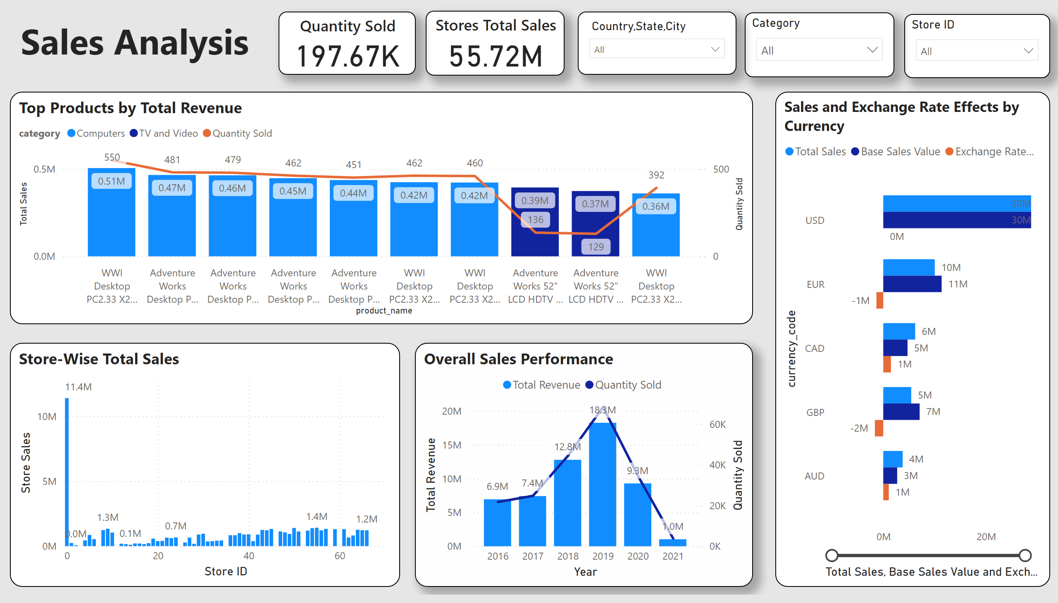
Sales Analysis
Notes:
Store ID
No alt text provided
Category
No alt text provided
Top Products by Total Revenue
No alt text provided
Sales and Exchange Rate Effects by Currency
No alt text provided
Overall Sales Performance
No alt text provided
Store-Wise Total Sales
No alt text provided
slicer
No alt text provided
textbox
No alt text provided
Stores Total Sales
No alt text provided
Quantity Sold
No alt text provided

Slide 9
Overall Sales Performance
Total Sales:
55.72M
This represents the total revenue generated.
Quantity Sold:
197.67K
The total number of units sold.

Slide 10
Top Products by Total Revenue
Top-Selling Products:
Products in the "Computers" and "TV & Video" categories.
Key Products:
WWI Desktop PC2.33 X2: 0.51M
Adventure Works Desktop P...: 0.47M
Adventure Works Desktop P...: 0.46M
Adventure Works Desktop P...: 0.45M
Adventure Works Desktop P...: 0.44M

Slide 11
Sales and Exchange Rate Effects by Currency
Currency Breakdown:
Total sales and exchange rate effects for USD, EUR, CAD, GBP, AUD.
Insights:
USD to EUR: After conversion, total sales decreased by $1 million.
CAD: Total sales increased by $1 million after conversion.
AUD: Total sales increased by $1 million after conversion.
GBP: Total sales decreased significantly by $2 million.

Slide 12
Store-Wise Total Sales
Top-Performing Store:
Store ID 0: 11.4M in sales.
Overall Sales Trends Over the Years
2016-2021:
Peak Revenue: 18.3M in 2019
Peak Quantity Sold: 60K in 2019

Slide 13
Actionable Insights
Product Focus:
Promote top-selling products more aggressively.
Investigate the reasons behind customer preferences for these products.
Currency Management:
Monitor exchange rate effects to minimize negative impacts.
Use dynamic pricing strategies to address currency fluctuations.
Store Performance:
Focus on stores with the highest sales.
Replicate successful strategies in high-performing stores to other locations.
Sales Trends Analysis:
Analyze 2019's peak sales and apply successful strategies to other years.
Adjust sales strategies according to yearly trends.

Slide 14
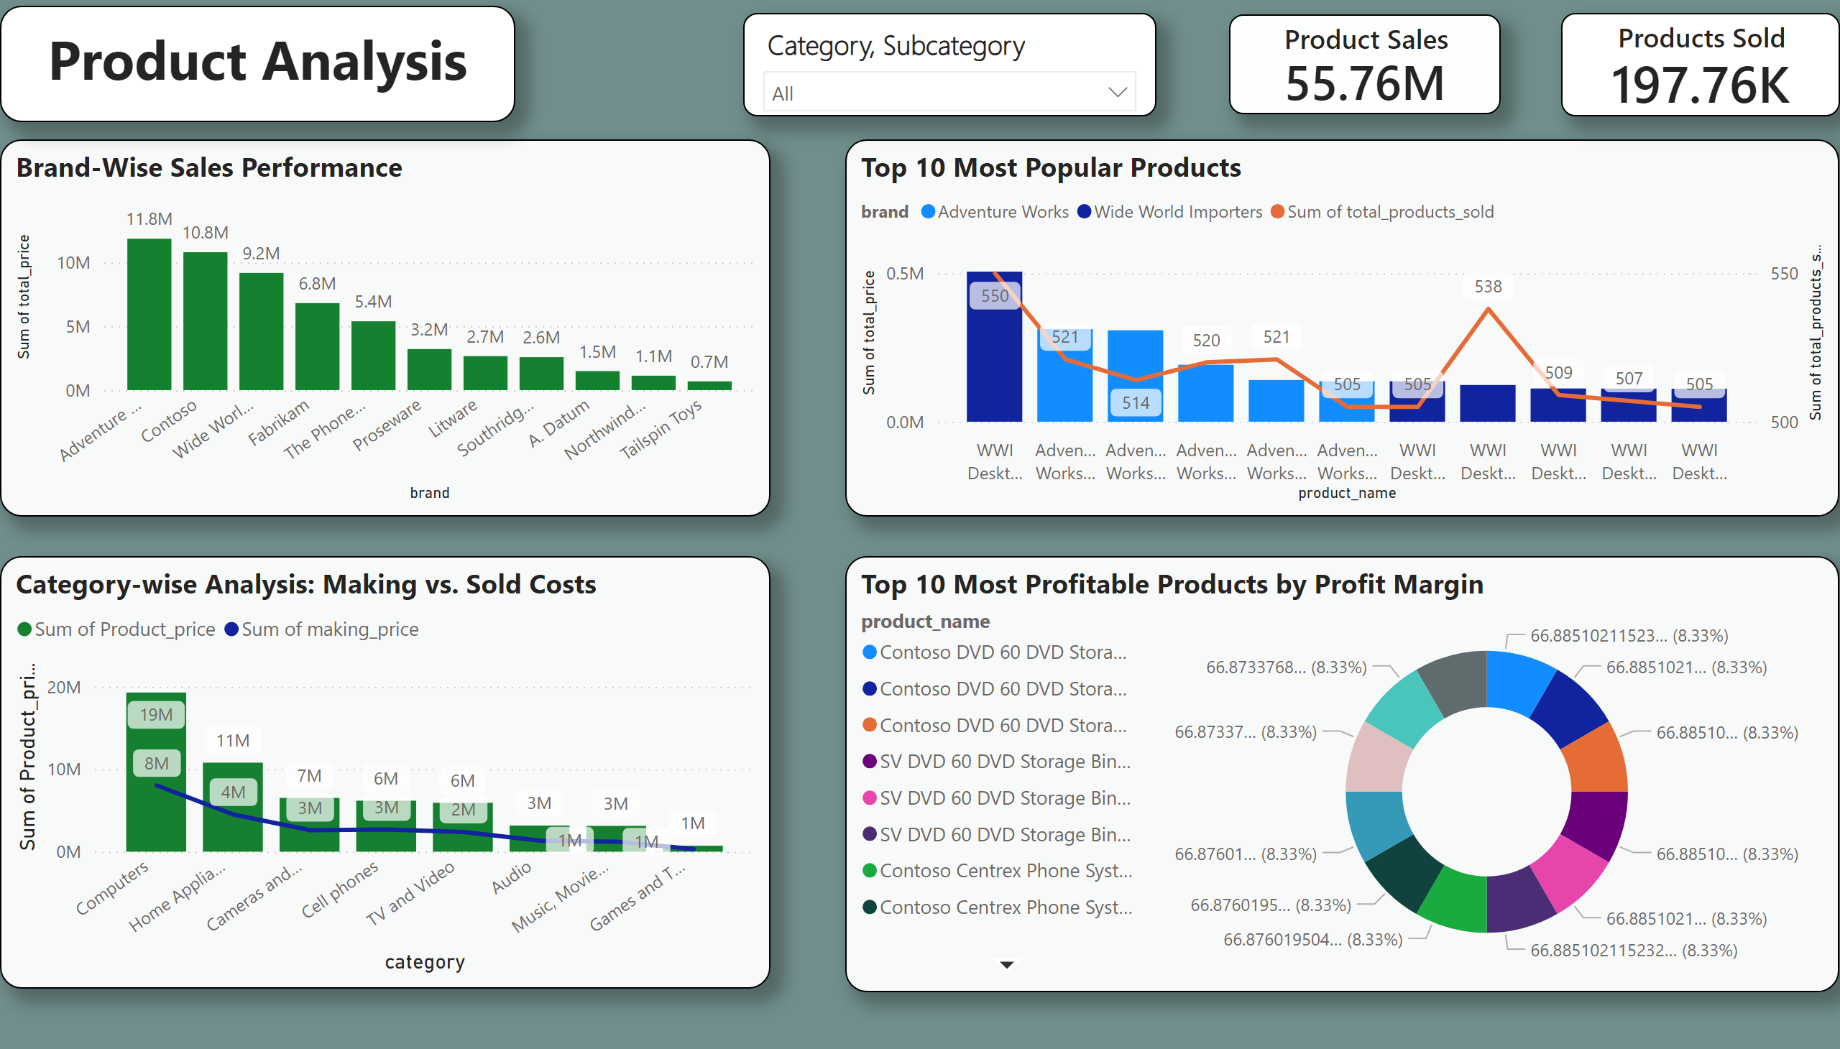
Product Analysis
Notes:
Brand-Wise Sales Performance
No alt text provided
Top 10 Most Popular Products
No alt text provided
Category-wise Analysis: Making vs. Sold Costs
No alt text provided
Top 10 Most Profitable Products by Profit Margin
No alt text provided
slicer
No alt text provided
Products Sold
No alt text provided
Product Sales
No alt text provided
textbox
No alt text provided

Slide 15
Top 10 Most Popular Products
Key Insight:
The WWI Desktop and various Adventure Works Desktop products dominate in both sales volume and units sold.
Actionable Insight:
Promote these high-demand products more aggressively in campaigns.
Monitor sales trends to maintain stock levels for these top-selling products.

Slide 16
Brand-Wise Sales Performance
Key Insight:
Adventure Works leads the sales with 11.8M, followed by Contoso and Wide World Importers.
Actionable Insight:
Focus marketing efforts on the top-performing brands.
Ensure adequate inventory and highlight these brands in promotions.

Slide 17
Category-Wise Analysis: Making vs. Sold Costs
Key Insight:
Computers lead in total sales with significant profit margins, followed by categories like Home Appliances and Cameras.
Actionable Insight:
Focus on high-margin categories for increased profitability.
Prioritize cost-effective production strategies for these categories.

Slide 18
Overall Metrics
Key Insight:
Total sales amount to 55.76M with 197.76K products sold, reflecting strong sales performance.
Actionable Insight:
Maintain the sales momentum with targeted marketing and efficient inventory management.
Analyze yearly trends to forecast and improve future sales.

Slide 19
Top 10 Most Profitable Products by Profit Margin
Key Insight:
Products like Contoso DVD 60 DVD Storage Bin and SV DVD 60 DVD Storage Bin have the highest profit margins (66.87% - 66.88%).
Actionable Insight:
Highlight these products in marketing campaigns for greater profit impact.
Consider increasing production or stock for these highly profitable items.

Slide 20
Final Thoughts:
Focus on the top-performing products and brands.
Leverage high-profit margins to boost overall profitability.
Ensure that high-demand items are well-stocked and promoted.
Use the insights to adjust future marketing strategies and inventory planning.

Slide 21
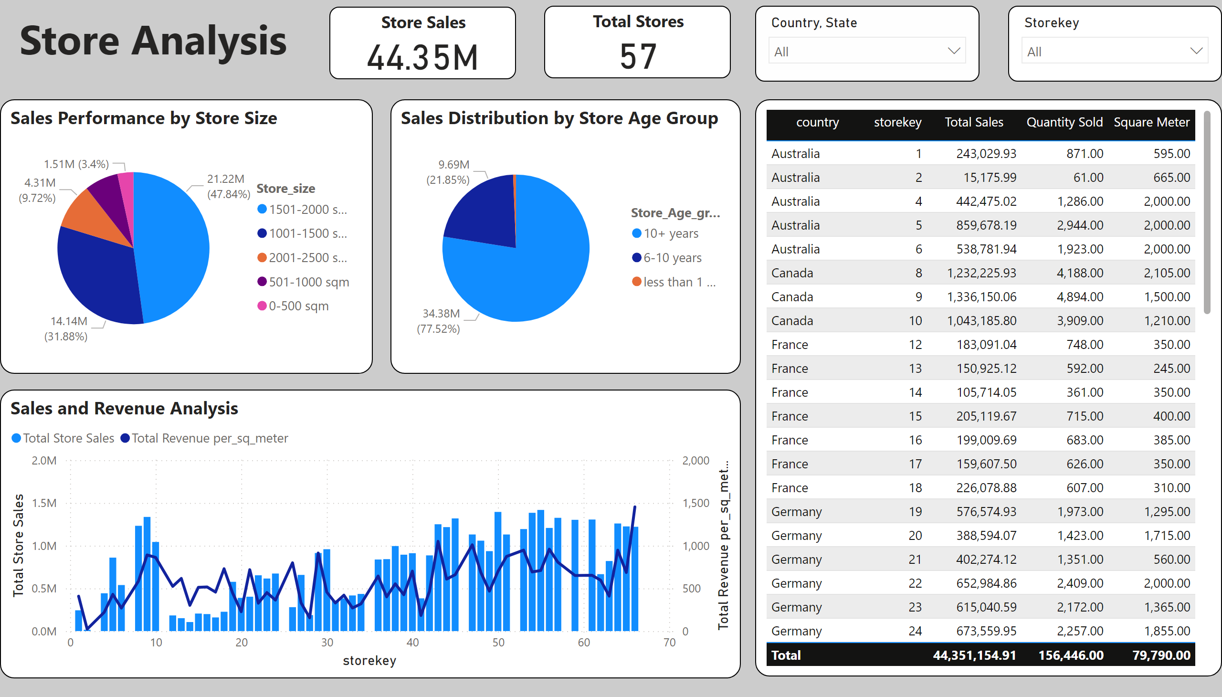
Store Analysis
Notes:
tableEx
No alt text provided
Sales and Revenue Analysis
No alt text provided
textbox
No alt text provided
Store Sales
No alt text provided
slicer
No alt text provided
slicer
No alt text provided
Sales Performance by Store Size
No alt text provided
Sales Distribution by Store Age Group
No alt text provided
slicer
No alt text provided
Total Stores
No alt text provided

Slide 22
Total Store Sales and Store Count
Total Store Sales: ₹44.35M
Total Number of Stores: 57
Quantity Sold : 156,446
Square Meter : 79,790
﻿At 1.42M, Storekey 55 had the highest Total Store Sales and was 9,242.95% higher than 2, which had the lowest Total Store Sales at 15.18K

Slide 23
Sales Performance by Store Size
Sales based on the size of the stores:
1501-2000 sqm: 47.84% of total sales
1001-1500 sqm: 31.88% of total sales
2001-2500 sqm: 9.72% of total sales
501-1000 sqm: 3.4% of total sales
0-500 sqm: 7.16% of total sales

Slide 24
Sales and Revenue Analysis
The bar and line chart illustrates total sales and revenue per square meter for different store keys:
- Stores with keys 1, 8, 13, 20, etc. show varying performances.

Slide 25
Sales Distribution by Store Age Group
Another pie chart shows sales based on how long stores have been operating:
10+ years: 77.52% of total sales
6-10 years: 21.85% of total sales
Less than 1 year: 0.63% of total sales

Slide 26
Insights
These total values give a holistic view of the business's performance across all stores, providing a benchmark for future growth and improvement.
Larger stores (1501-2000 sqm) are driving nearly half of the total sales. This could be due to higher inventory capacity and potentially better customer experience.
Comparing the sales and revenue per square meter can help identify which stores are most efficient in utilizing their space to generate revenue.
Older stores (10+ years) dominate sales. This may indicate that established stores have a stronger customer base and brand loyalty.

Slide 27
Detailed Store Data
Australia (Store Key 1):
Total Sales: ₹2,43,029.93
Quantity Sold: 871
Square Meter: 595
Canada(Store Key 8):
Total Sales: ₹12,32,225.93
Quantity Sold: 4188
Square Meter: 2105
France (Store Key 13):
Total Sales: ₹1,50,925.12
Quantity Sold: 592
Square Meter: 245
Germany (Store Key 20):
Total Sales: ₹3,88,594.07
Quantity Sold: 1423
Square Meter: 1715
In summary, the analysis indicates that larger and older stores contribute significantly to sales. Focusing on strategies to replicate the success of these stores in newer and smaller ones might be beneficial. Additionally, understanding the reasons behind the high performance of certain stores, like the one in Canada, can help in applying best practices across all locations.

Slide 28
Key Insights & Recommendations
Insights:
- Focus on the Frequent Buyers segment to drive more revenue.
- Explore opportunities to improve profitability in underperforming categories.
- Leverage popular products to enhance brand loyalty.
- Target marketing campaigns for the 65+ age group.

